Slide 1

SAP Datasphere Training – Day 1
www.anubhavtrainings.com

Slide 2
Agenda
Who is this course for?
01
Try to map your current profile and role to the training. Grow your skills to maximise on market opportunities.
Designed for an Absolute Beginner / SAP BW or BW/4HANA Consultants willing to venture into the Cloud technologies to upskill.
On-premise v/s Cloud
02
Considering solution types and understanding difference between cloud and on-premise system
www.anubhavtrainings.com
Introduction to SAP Datasphere
03
Understand the definitions of Datasphere and use cases, What can you expect in this course
System Setup and Walk-through
04
Create SAP Datasphere account and get started with new system with menu options

Slide 3




Who is this course for?
Steve
Robert
Julia
Nick
SAP BW Consultant
12 Years
BW/4HANA Consultant
6 Years
Solution Architect
18 Years
Any / SAC SAP Consultant
2 Years
Would like to learn Cloud technologies on SAP BW – SAP Datasphere aka SAP Datawarehouse Cloud
My company is moving data to cloud and asked me to explore data warehouse technologies in cloud
Want to understand a holistic view of all SAP Cloud and On-premise technologies to plan Go to market
Explore opportunities in new SAP Technical areas like SAP Analytics and Big Data technologies

Slide 4

Introduction to Datasphere
SAP Datasphere is a SaaS offering from SAP which uniquely harmonizes mission-critical data across the organization, unleashing business and technical experts to make the most impactful decisions. It combines previously discrete capabilities into a unified service for data integration, cataloging, semantic modeling, data warehousing, and virtualizing workloads across SAP and non-SAP data.
A secure environment supporting diverse data application needs including real-time analytics, governed data access
A wide range of connections to SAP and non-SAP cloud and on-premise sources, including data lakes.
DATA WAREHOUSE
SAP DWC
CONNECT
EXPLORE and MODEL
SAP’s Data warehouse cloud – All your data at one source in cloud
CONSUME
Graphical low-code/no-code tools to support self-service modeling needs for business users.
Seamless integration with SAP Analytics Cloud, Microsoft Excel, and public OData APIs to support consumption by other clients, tools, and apps.

Slide 5



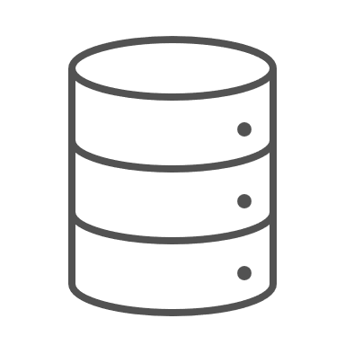
Course Outlook
02
04
Product Introduction
Data Modeling
Understand the SAP DWC / Datasphere product, usage, implementation strategy and architecture
Understanding Business Data modelling and consumptions using SAC
DATA ANALYSIS
01
Data Builder
03
Integrations and Administration
Bring data from different sources or create data natively using Data Builder Portfolio
Build Integrations with different SAP Systems and scenarios. Administer and control data and permissions.

Slide 6
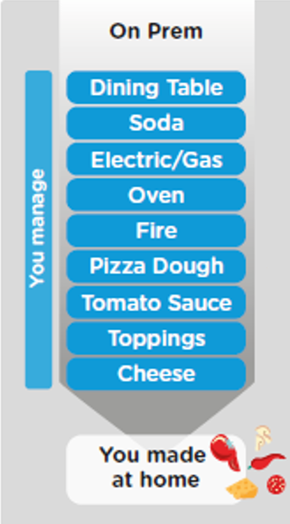
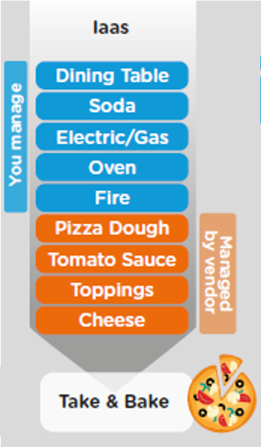
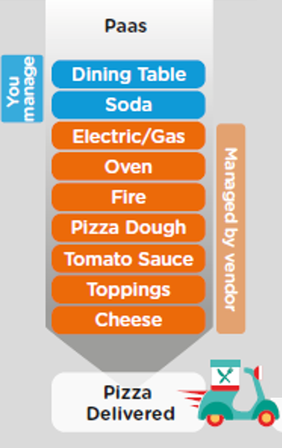
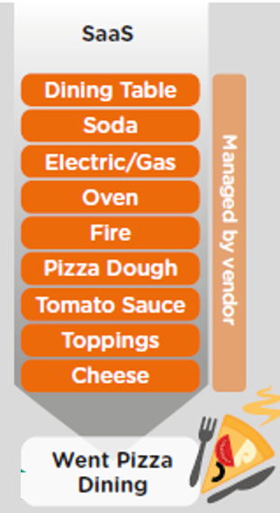
On-premise v/s Cloud System

Slide 7




What does Cloud offers ?
Application
Application
Data
Data
Runtime
Platform as a Service
Managed by SAP implementing open source CF
Middleware
Fully ready landscape with reusable services
Scalability
Elasticity
Low TCO
Database
OS
Managed by Infrastructure
providers
Data Centers
Service Portfolio
Virtualization
Infrastructure as a Service
Servers
Storage
Networking

Slide 8
Difference between Cloud and On premise
An On-premise software requires following
Hardware and Software DVD needs to be purchased
Networking needs to be setup
License needs to be purchased by paying a lump-sum amount for multi-year
Hire professionals (Basis consultants) to manage this software
Upgrades and support packs needs to be updated by your team, including test, some downtime
Initial investment TCO is very high
Scalability is hard to achieve
Example – SAP BW, SAP BW/4HANA, SAP ECC, S/4HANA, BOBJ, HANA OP, Outlook
Cloud Solution needs
Customers do not need to buy any hardware; the hardware will be setup by vendor
We consume just software as SaaS, There is no installation needed in your co.
No need to hire Basis professionals
Complete upgrade and hotfixes is the responsibility of vendor
We use subscription model where we pay per user, per month, Scalability is easy to achieve
Faster innovation cycle, Faster adoption, Lower TCO
Example – Gmail, Netflix, Uber, S/4HANA Cloud, SAP Datasphere, SAP Analytics Cloud

Slide 9
What is SAP BTP?
SAP BTP is a Platform as a Service offered by SAP for developers and development teams. It offers tools, services, runtimes, databases, technology, life cycle, CI/CD, logging, tracing, troubleshooting, connectivity etc. to build SaaS applications.
The platform itself runs on top of IaaS which is provided by AWS, GCP, Azure.
We can check the platform features and applications which are built on top of platform below
https://discovery-center.cloud.sap/serviceCatalog
SAP Datasphere and SAP Analytics cloud are separate SaaS hosted on top of SAP BTP platform. Behind the scenes the data is stored inside the HANA cloud system, it is a Database as a service on top the BTP.

Slide 10
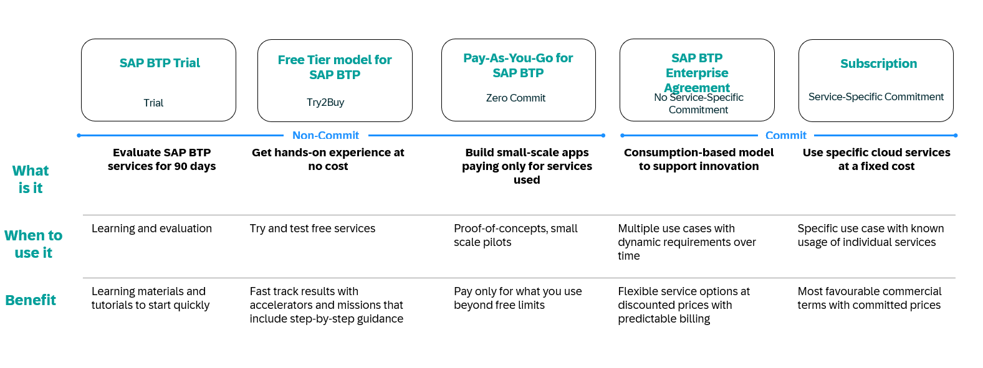
What are the Datasphere Service plans?
BTP offers two different commercial models for BTP enterprise accounts Consumption and Subscription:
Consumption-based commercial model in the flavors
BTPEA (SAP BTP Enterprise Agreement) – new license introduced as of April 2024
Cloud Platform Enterprise Agreement (CPEA) - for existing CPEA Accounts
Pay-As-You-Go (PAYG)
Subscription-based commercial model.
Notes:
Some services are Always Free, which indicates that the service offers a service plan that is free of additional charges, as it is already included in your overall SAP BTP contract.
TThe consumption-based models Pay-As-You-Go (PAYG) and SAP BTP Enterprise Agreement (BTPEA) / Cloud Platform Enterprise Agreement (CPEA) offer, in addition, Free Tier Service Plans for specific services.
Free Tier Service Plans allow you to trial certain SAP services within your enterprise account free of charge to see if they can meet your needs.
For an overview of Always Free & Free Tier services, visit SAP Discovery Center Services.
Consumption-based commercial model
With the consumption-based model, your organization purchases an entitlement to all current and future SAP BTP services that are eligible for this model. Throughout the duration of your contract, you have complete flexibility to turn services on and off and to switch between services as your business requires.
The consumption-based commercial model is available in the following flavors:
BTPEA (SAP BTP Enterprise Agreement) – new license introduced as of April 2024
CPEA (Cloud Platform Enterprise Agreement) - for existing CPEA Accounts
and Pay-As-You-Go for SAP BTP
SAP BTP Enterprise Agreement (BTPEA)
BTPEA is an evolution of the existing Cloud Platform Enterprise Agreement (CPEA) commercial model.
BTP services can be used when demand arises and be retired when not needed anymore.
Your organization makes a prepaid investment in cloud credits for the contract duration and makes an annual commitment to consume SAP BTP services.
This model is suitable for customers with well-established and planned use cases who want the flexibility of turning services on and off and switching between services without the commitment of being tied to a single service throughout the duration of the contract.
You receive a monthly balance statement that provides information about the usage consumption of each service and the corresponding costs. The total monthly cost is deducted from your cloud credits balance.
This model has a minimum investment entry, and volume-based discounts are available.
You are billed annually in advance. Any overages are billed in arrears at the list price.
You can top up your cloud credits at any time to prevent overages.
You get the new BTP services
BTPEA global accounts do not support SAP BTP, NEO environment.
Please look at the Discovery Center services for the complete list of supported services.
https://developers.sap.com/tutorials/btp-ea-onboard-01-intro..html

Slide 11
Where does Data Warehouse fits?
Notes:
In computing, a data warehouse (DW or DWH), also known as an enterprise data warehouse (EDW), is a system used for reporting and data analysis and is considered a core component of business intelligence.^{[1]} Data warehouses are central repositories of integrated data from one or more disparate sources. They store current and historical data in one single place^{[2]} that are used for creating analytical reports for workers throughout the enterprise.^{[3]} This is beneficial for companies as it enables them to interrogate and draw insights from their data and make decisions.[

Slide 12
What is HANA and BW/4HANA?
HANA stands for High Performance Analytic Appliance; it is an In-memory database provided by SAP.
Is a on-premise data warehouse solution which is natively designed to run on HANA DB.

Slide 13
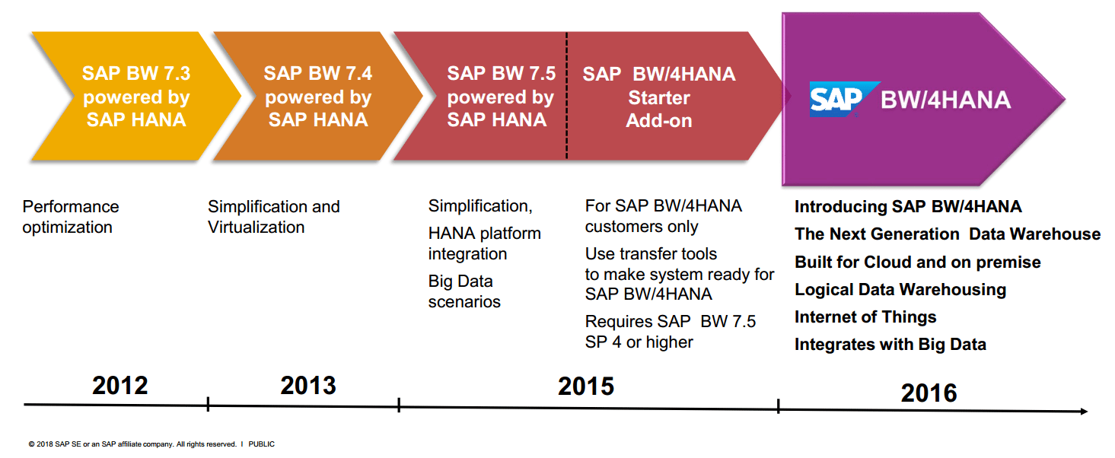
Evolution of SAP BW

Slide 14
What is SAP Datasphere aka Data Warehouse Cloud?
SAP Datasphere is the next generation of SAP Data Warehouse Cloud, enabling a business data fabric. It offers a unified experience for data integration, cataloging, semantic modeling, warehousing, federation, and virtualization.
A comprehensive data service built on SAP Business Technology Platform (SAP BTP) that enables every data professional to deliver seamless and scalable access to mission-critical business data.
It allows us to converge data coming from SAP and third party on-premise and cloud environments into a single, fully managed cloud environment to allow your organization to radically simplify your data warehouse landscape. It was first introduced in 2019 and name changed happen in March 2023.
As utilities generate vast amounts of data, SAP Datasphere provides benefits such as scalability, cost savings, accessibility, and data security.
Utilities can adopt a cloud-only approach, a hybrid approach where only parts of the data warehouse move to the cloud or use the SAP BW Bridge to leverage their existing investments in SAP BW/4HANA in the cloud.
On top of SAP Datasphere, SAP Analytics Cloud provides advanced analytics, planning, and predictive capabilities to enable better data-driven decision-making, and SAP Digital Boardroom is an add-on that provides real-time insights into integrated line-of-business data for top decision-makers in utilities companies.

Slide 15
Benefits of Datasphere
A secure environment supporting diverse data application needs including real-time analytics, governed data access, a data catalog, and data science (machine learning).
Spaces, which are created and provisioned centrally to provide secure modeling environments for different departments or use cases.
A wide range of connections to SAP and non-SAP cloud and on-premise sources, including data lakes.
Graphical low-code/no-code tools to support self-service modeling needs for business users.
Powerful built-in SQL and data flow editors for sophisticated modeling and data transformation needs, along with support for 3rd party tools and other SAP IDEs.
An embedded data marketplace to consume external data products and to create internal data products.
A business user-friendly data matching environment to enrich existing datasets with external data, coming from Data Marketplace, csv uploads, and other 3rd party sources.
A catalog to support self-service discovery of data and analytic assets, glossaries and terms, and key performance indicators.
Multi-dimensional modeling with powerful analytical capabilities and built-in data preview.
A graphical impact and lineage analysis to visualize data movements, transformations, and other dependencies.
Cross-space collaboration and sharing of centrally governed sources for joining with local files and external sources with support for row-level security.
Re-use and migration of trusted and governed meta and data models residing in on-premise SAP Business Warehouse and SAP SQL Data Warehouse implementations.
Seamless integration with SAP Analytics Cloud, Microsoft Excel, and public OData APIs to support consumption by other clients, tools, and apps.

Slide 16
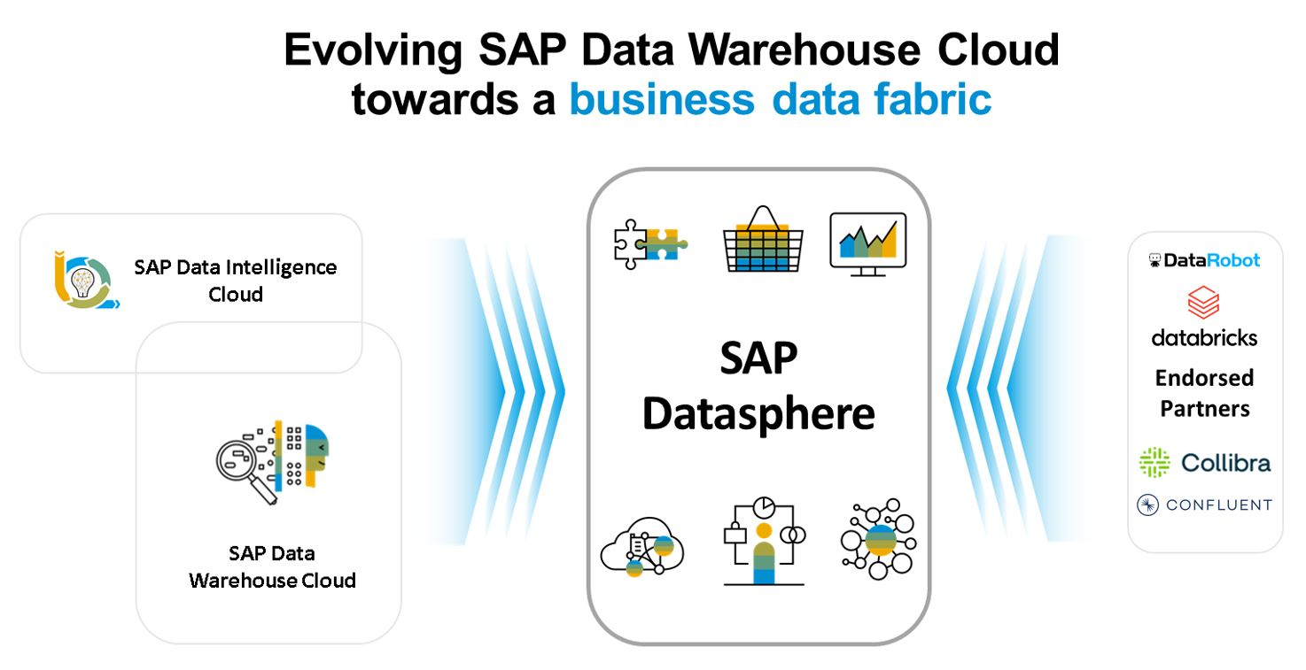
What is Datasphere How it evolving from DWC?

Slide 17
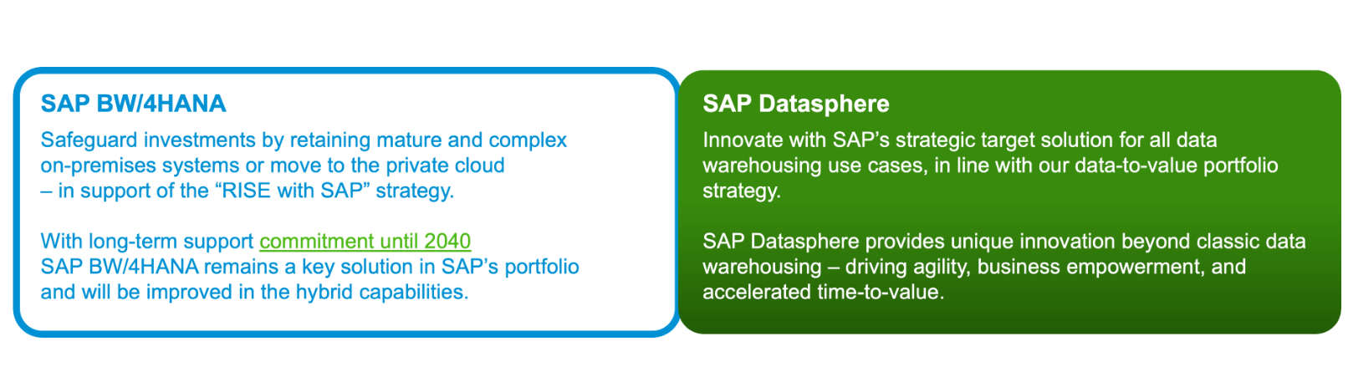
Statement of Direction

Slide 18
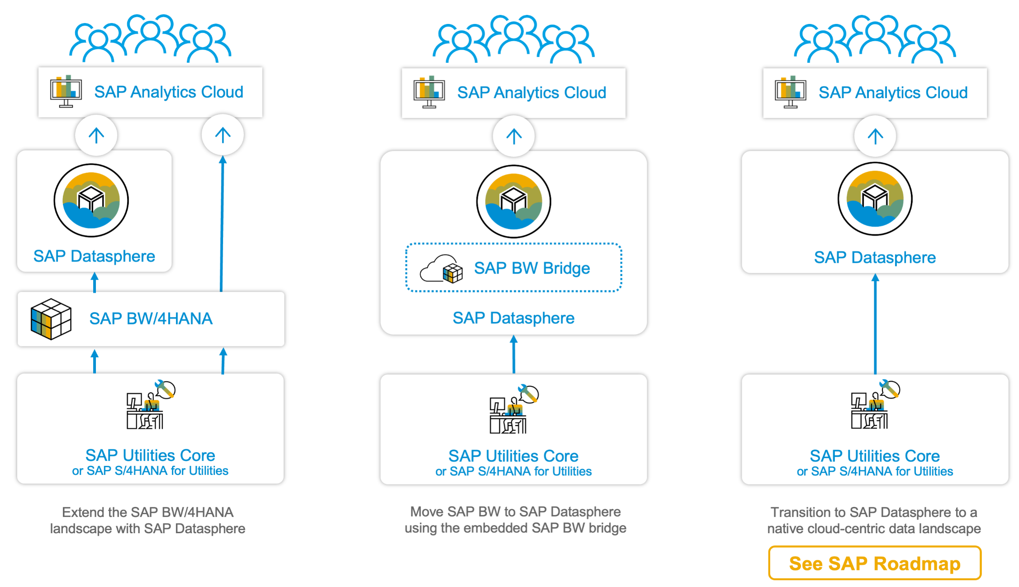
Implementation Strategy?

Slide 19
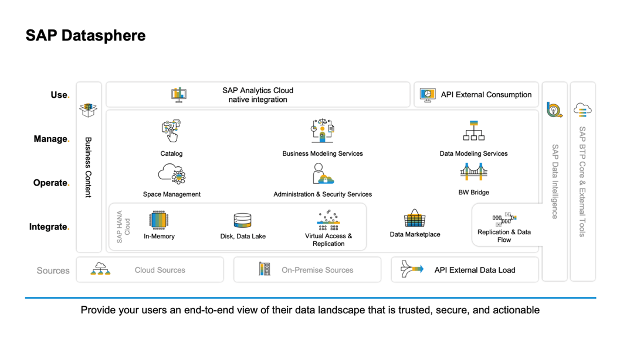
Datasphere Architecture

Slide 20
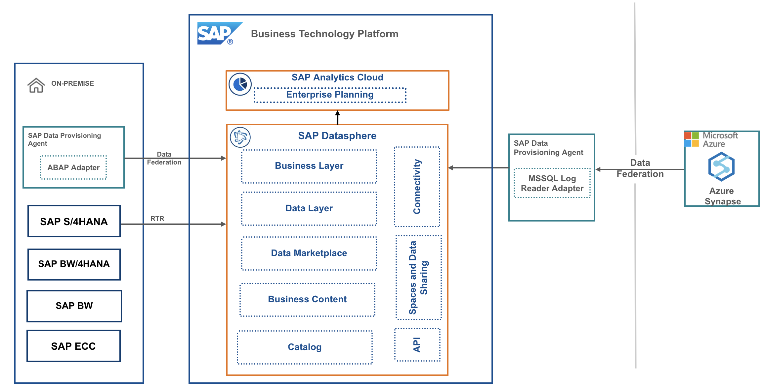
Developer’s Bird eye view

Slide 21
What is SAP Analytics Cloud?
SAP Analytics cloud is also a SaaS provided by SAP which offers the capability to do data reporting. It is independent product from datasphere. It helps companies to take informed and confident decisions powered by AI.
Decision making = past data
Confident decision making = insights
Turn insights to action
SAC enables intelligent enterprises to transform your data to insights by providing everyone a central place for data analysis using different choice of options. You can build dashboards, stories which are mobile ready, applications or a digital boardroom experience.

Slide 22
How Datasphere is different from SAC?
SAP datasphere is intended for data storage, data governance, data security. SAC is just a reporting tool with very limited capability for data governance.
Datasphere is built for long term data storage and centralized data management system, SAC is intended to build dashboard and interactive applications used by end users.
Datasphere is the source of data and SAC is the consumer of the data.
Both are seamlessly integrated yet cost you separate subscription fees.
Datasphere offers the capability for ETL and complex replication flows but SAC do not offer it
Datasphere offers also advance modeling choices to choose from and categorization of the data. SAC do not offer the advanced modeling.
Datasphere comparatively have high volume and usage of memory as compared to SAC.
We can integrate both solutions back and forth.
Using datasphere we can just preview the data, but we cannot build advanced data insights. SAC can also be used to do collaborative enterprise planning.
Notes:
DWC is not intended for planning, forecasting, and building stories and dashboards
DWC is built for long-term data storage and centralized data management (single source of enterprise data), however SAC is ad-hoc data service to take advantage of DWC
DWC is a cloud alternative of BW and SAC is cloud alternative of BOBJ and BPC
DWC offers data governance, linage, replication, ETL capabilities, but SAC used only for simple modeling and Reporting
Large no. of integrations are available in DS over the SAC

Slide 23

Getting Started
Free Trial for SAP Datasphere and SAP Analytics Cloud
https://developers.sap.com/tutorials/sac-guidedexperiences-getstarted.html

Slide 24
Buy Productive instance
Buying Productive system and calculating cost
https://www.sap.com/products/technology-platform/datasphere/pricing.html?countryCode=US
https://dwc-pricing-calculator-sac-saceu10.cfapps.eu10.hana.ondemand.com/index.html

Slide 25
System Walkthrough
Repository Explorer : Browse and create objects in repository.
Catalog – Place where you can search the business documentation of our objects. And if you feel the same is useful for you, you can make a copy or reuse the same.
Data Marketplace – Purchase data products from providers and download them directly into our space.
Data Builder – Create and import tables, views, create data flows and ER diagram. This is the core of our data layer.
Business Builder – Create business entities, fact models, and consumption models to present data to consumption tools.
Data Access Control – We can manage criteria based privileges to filter the data accessible in views and business data objects.
Data integration Monitor – we can check memory consumption of replicated tables, data integration flow and task chain monitor when ETL runs, what the time taken and status our jobs.
Connections – This is where we stablish connections to exchange data between different SAP / Non-SAP, Cloud /On premise systems with Datasphere.

Slide 26
System Walkthrough
Space Management – These are the fundamental concept of DS, here we manage the overall memory we are allowed to connect and manage our work area. Think like your private package in SAP BW.
Content Network – one hand provides you access of sample business content from SAP and SAP’s partners network.
Security – where we configure system administration like SSO, HANA Cloud, Whitelisting, Users, Roles.
Transport – allows us to export and import content from one DS tenant to another.
Data sharing cockpit – to share your data on data marketplace and manage licenses.

Slide 27
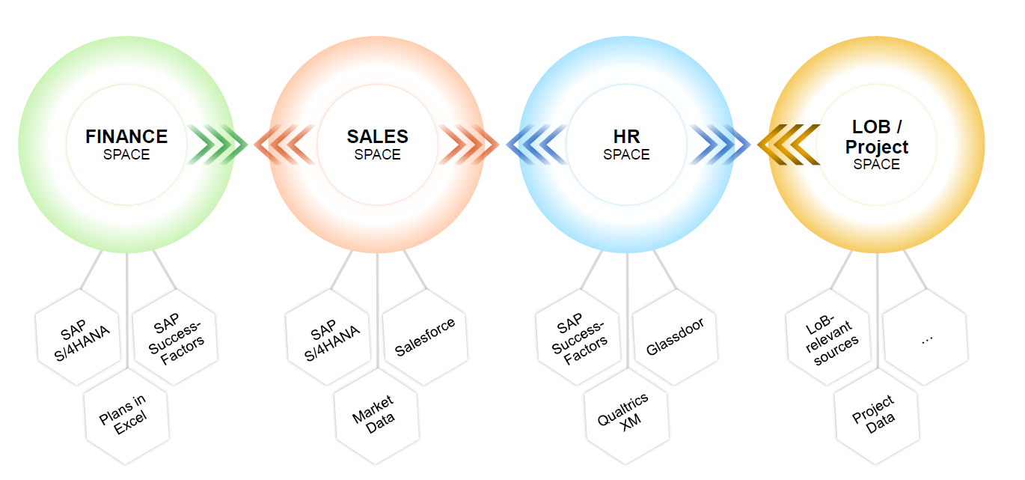
What is Spaces in Datasphere?
Spaces are secured virtual work environments which
– provide isolation for metadata objects and space resources
– define storage quota, control resource usage, and workload class settings per space
– maintain space-specific source system connections and a common time dimension
– manage user access for space members
– enable sharing of data and currency conversion settings with other spaces
Exercise – Space management
Notes:
Spaces allows administrators to curate specific data and sources into a shared, subject oriented workspace for managed users to access and work with. The concept here is to take all those disparate data sources and make them actionable and organized. Spaces organize data in a meaningful manner for users rather an unintelligent dump.

Slide 28
Helpful links
Useful resources during and after the course
SAP Datasphere product Roadmap
SAP community pages
– Get started
– Best practices
– Business content
– SAP BW Bridge
SAP online documentation
SAP tutorials for developers
SAP learning journey

Slide 29

What We Did
Let’s Summarize

Slide 30

www.anubhavtrainings.com
Thank You
End of Day 1

Slide 31


We’re committed to empower you to be
#FutureReady
through powerful training solutions.
We build the workforce of the future.
250+
Corporate Clients
30,000+
Learners Trained
25000+
Learners Placed
FREE WEBINARS
Sign up for free webinars with industry experts every fortnight!
Enroll Now!
Contact us today!
https://anubhavtrainings.com

